Slide 1
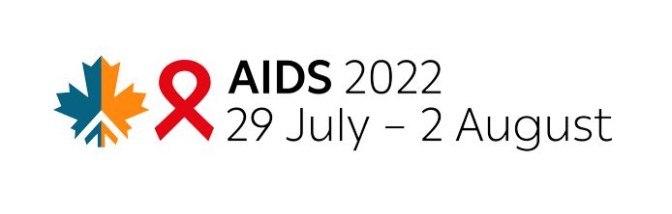

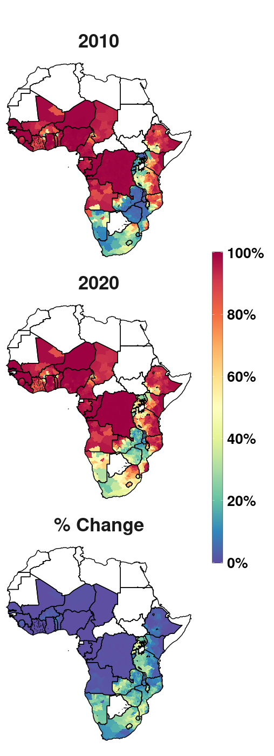
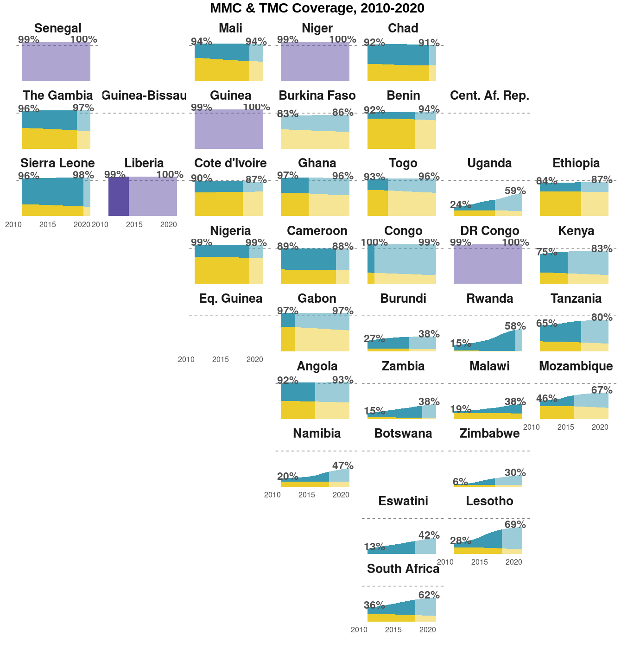
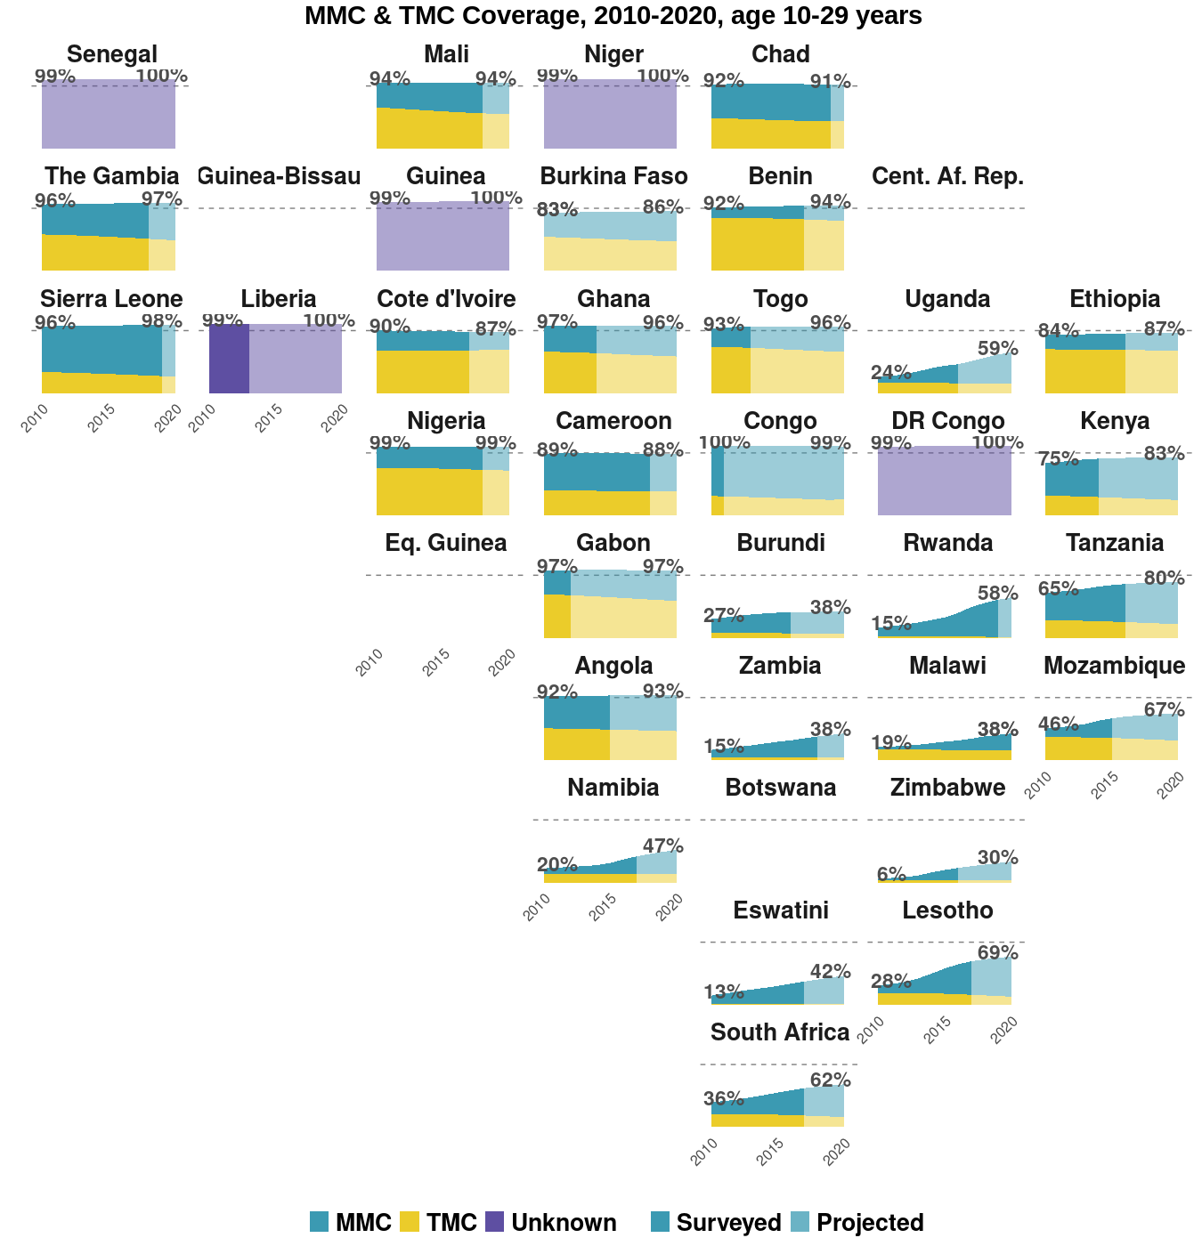
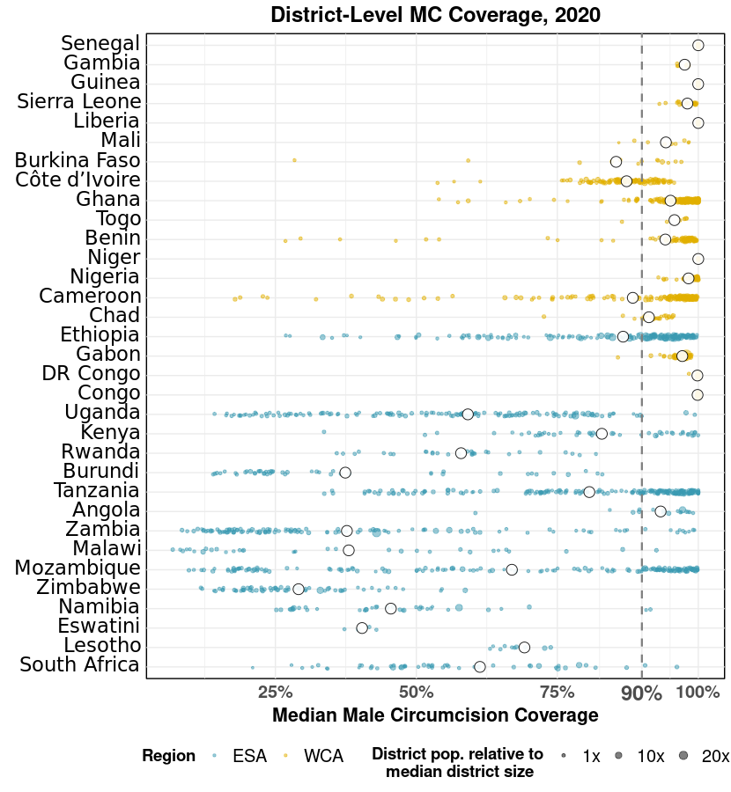
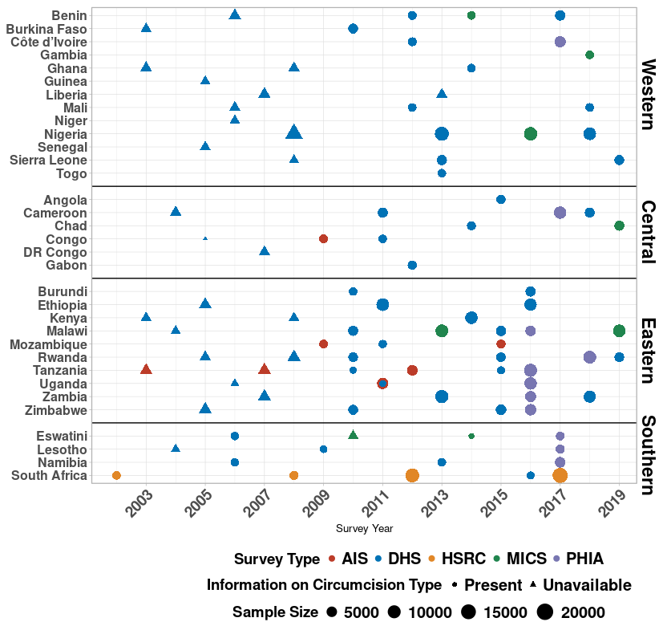
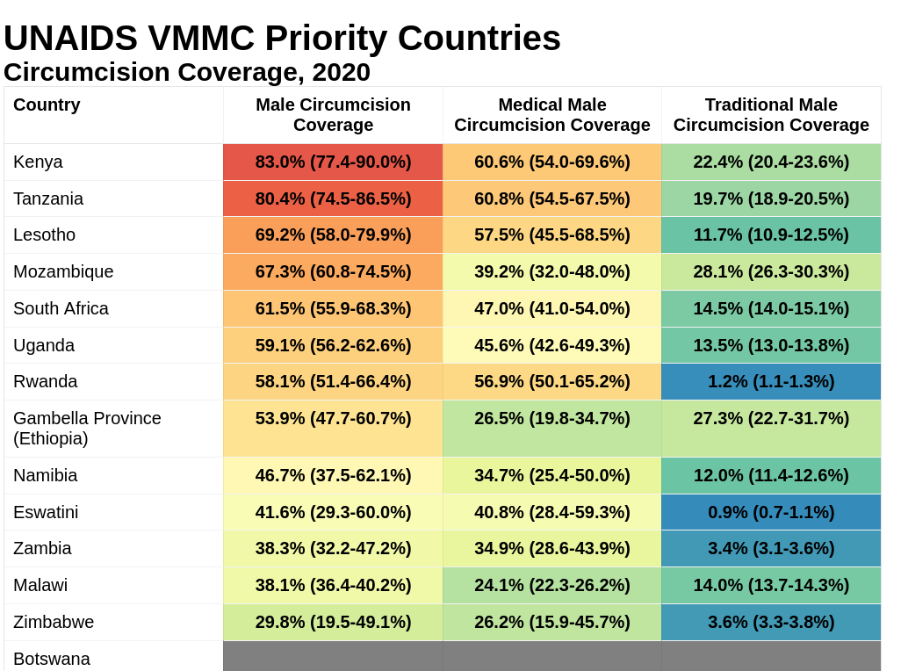
District-level medical and traditional circumcision coverage and unmet need among men aged 10-29 years in sub-Saharan Africa (Abstract #111272)
Patrick O’Toole¹, Matthew L Thomas^{1,2}, Oliver Stevens¹, Kevin Lam^{1,3}, Katharine Kripke⁴, Rachel Esra¹, Ian Wanyeki⁵, Lycias Zembe⁵, Jeffrey W Eaton¹
(1) MRC Centre for Global Infectious Disease Analysis, School of Public Health, Imperial College London, (2) Joint Centre for Excellence in Environmental Intelligence, University of Exeter & Met Office, (3) Department of Statistics, University of British Columbia, (4) Avenir Health, Takoma Park, MD, USA, (5) Joint United Nations Programme on HIV/AIDS (UNAIDS)
Introduction
Results
Background
UNAIDS targets 90% male circumcision (MC) coverage for 10-29 year olds by 2021 in 14 sub-Saharan Africa (SSA) priority countries [1]
Substantial variation across SSA in:
Traditional Male Circumcision (TMC) practises and
Voluntary Male Medical Circumcision (VMMC) implementation
Aims
Produce detailed district-level circumcision coverage estimates to:
Assess progress towards targets
Identify remaining gaps towards VMMC HIV prevention targets
Understand variation in traditional and medical male circumcision (MMC) across SSA to support future VMMC planning
MC Coverage, 2010-2020
Methods
Figure 3: lighter shading indicates “projected” period after last known survey
Data
120 household surveys conducted in 33 SSA countries, conducted between 2002-2019 (F1)
Individual-level, self-reported circumcision:
Status (MC vs uncircumcised)
Type (MMC vs TMC)
Age at circumcision
District-level populations from WorldPop [2]
Model
Bayesian spatio-temporal, competing-risks, time-to-event model [3]
Stratified by age, location & time
Estimates MC, TMC and MMC Rates
Projected assuming continuation of age-specific rates with probabilistic uncertainty
Assume rate of TMC constant over time; time-varying rate of MMC estimated from survey data [3]
Figure 2
27.5m additional men require medical circumcision to reach 90% coverage in all 33 SSA countries
Progress, 2010-2020:
53.0 million (95% CI 49.5-58.6m) men circumcised
31.7m (25.2-43.5m) MMCs
11.3m (5.0-13.4m) TMCs
Rwanda had the largest total MC increase of 43.3% (37.0-51.2%) from 14.8% to 58.1% (F2)
Lesotho had the largest MMC increase of 47.0% (35.9-57.1%) from 10.5% to 57.5%. (F3)
In 2020:
Total MC coverage ranged from 29.8% (Zimbabwe) to 100% (Niger) (F2)
Within countries, median district MC range was 39.4%, largest variation in Zambia (8.7% to 98.9%) (F4)
The Congo had highest MMC coverage: 76.1%
Benin had lowest MMC coverage: 22.5%
Benin highest TMC coverage: 71.7%
Eswatini had the lowest TMC coverage: 0.9% (F3)
Household surveys in each country
Figure 1
Figure 4
Figure 5
UNAIDS VMMC Priority countries
In 2020, no countries had reached the 90% MC coverage target set for 2021 (F5)
→ 19m MCs performed 2010-2020
→ 20m additional MCs required
This belies large subnational variation: 23% (14-32%) of priority country districts have achieved 90% MC by 2020 (F4)
References
[1] World Health Organization. A framework for voluntary medical male circumcision: Effective HIV prevention and a gateway to improved adolescent boys’ and men’s health in Eastern and Southern Africa by 2021, 2016. URL
https://apps.who.int/iris/bitstream/handle/10665/246234/WHO-HIV-2016.17-eng.pdf?sequence=1.
[2] Linard, C., Gilbert, M., Snow, R.W., Noor, A.M. and Tatem, A.J., 2012, Population distribution, settlement patterns and accessibility across Africa in 2010, PLoS ONE, 7(2): e31743.
[3] Thomas, M. L. κ.ά. (2021) ‘A multi-level model for estimating region-age-time-type specific male circumcision coverage from household survey and health system data in South Africa’. arXiv. doi: 10.48550/ARXIV.2108.09142.
Conclusions
Traditional and medical circumcision practices vary substantially between and within countries
VMMC programmes have made substantial, but uneven, progress towards MC targets
Granular district level data provide information for focusing further VMMC implementation

